Slide 1

Tutorial on IQM Tools Pro
MEX / Systems Biology/Pharmacology Projects
Integrated Solutions for Quantitative Drug Development
From Mechanistic Models to Complex Trial Simulation
Henning Schmidt, IntiQuan GmbH
2

Slide 2
Tutorial Outline
General introduction to the IQM Tools Suite
High performance computation via MEX simulation functions
Model Simulation
  Standard
  Parametric sensitivity
IQMprojectSB - parameter estimation, model reduction
  Projects
  Parameter estimation / manual tuning / parameter fit analysis / parameter identifiability analysis
  Model reduction
  Simulation of projects
  Commenting of projects

Slide 3
Tutorial Info
In large parts you will have the opportunity to get hands-on-experience
>> installIQMtoolsInitial
Commands shown in these boxes should be entered on the MATLAB
command line, during the tutorial
********** MODEL NAME
Simple model
********** MODEL STATES
d/dt(A) = -R
d/dt(B) = R
A(0) = 1
B(0) = 0
********** MODEL PARAMETERS
k1 = 0.5
********** MODEL REACTIONS
R = k1*A
Text shown in these boxes should
be entered where appropriate
(will become clear later)

Slide 4
Tutorial Goal: „You should be able to“
Use MEX/C-code models for fast simulation
Calculate sensitivity trajectories with MEX models
Set up your own parameter estimation project
  Model description
  Measurement data
  Experiment descriptions
Perform parameter estimation, identifiability analysis, etc.
Analyze the resulting model

Slide 5
Tutorial Outline
General introduction to the IQM Tools Suite
High performance computation via MEX simulation functions
Model Simulation
IQMprojectSB - parameter estimation, model reduction

Slide 6
Introduction to the “IQM Tools Suite”
The IQM Tools Suite is provided freely and as open source
The IQM Tools Suite consists of two main packages
  IQM Tools Lite
  IQM Tools Pro
The whole is based on MATLAB (www.mathworks.com)
IQM Tools Lite
Model, experiment, measurement & dosing representation, simulation, analysis functions, optimization, signal processing, statistical functions, etc.
IQM Tools Pro
Systems biology/pharmacology and PMX functionality, clinical data analysis, nonlinear mixed effect modeling, clinical trial simulations, high speed simulation through transparent C-code interface

Slide 7
Modular Design of the IQM Tools Suite
MONOLIX
NONMEM
IQM Tools Pro (pmx) (population PKPD, workflows, trial simulation, ...)
IQM Tools Pro
(sys)
(parameter
determination
functionality)
GUI Functions
(Model editing, visualization, etc.)
IQM Tools Lite
Functions
(Analysis, Simulation, etc.)
Optimization
Algorithms
SUNDIALS
CVODES
Powerful
Solvers
Low-Level Functions
(creating, converting objects)
Signal Processing
functions
Statistical
functions
IQMprojectSB
IQMmodel / IQMmeasurement
IQMexperiment/IQMdosing
SBML
Toolbox
MEX
MATLAB
ODE FILE
..., ..., ...

Slide 8
Requirements
MATLAB R2013b (or later)
  Model reduction methods require the Symbolic Toolbox
  Availability of the Parallel Toolbox useful for the Pharmacometric functions in IQM Tools Pro
Optional 3rd party software
  Monolix Version 4.2.3 (or later) (http://www.lixoft.org)
  NONMEM Version 7.2 (or later) (http://www.iconplc.com)
  SSm Global Optimization Toolbox (http://www.iim.csic.es/~gingproc/ssmGO.html)
  SBML Toolbox (http://sbml.org/Software/SBMLToolbox)
    Only needed for Unix/Linux/Mac
    For Windows it is included in the distribution of the IQM Tools Lite

Slide 9

Where to get IQM Tool Suite from?
Free download of IQM Tools Suite available from the IntiQuan webpage
The IQM Tools Suite is distributed as a ZIP file with both IQM Tools Lite and IQM Tools Pro included
Unzip this ZIP file on your computer at a location where you want to store the IQM Tools
www.intiquan.com

Slide 10
How to Install the IQM Tool Suite?
Start MATLAB
Change into the “IQM Tools Suite” folder
Read and update custom information in setup files:
  IQMlite/SETUP_PATHS_TOOLS_IQMLITE.m
  IQMpro/SETUP_PATHS_TOOLS_IQMPRO.m
Execute the “installIQMtoolsInitial” script
You need to execute the “installIQMtoolsInitial” script once after obtaining a copy of IQM Tools. This will compile required libraries.
After this first installation, you can use the function “installIQMtools” to install IQM tools. This needs to be done each time you exit and start MATLAB again. This is on purpose for compliance and reproducibility reasons.
If you do not care about compliance, you might want to consider the use of a startup.m script (see http://www.mathworks.com/help/matlab/ref/startup.html).

Slide 11
Installation of optional 3rd party software
Please follow the providers instructions when installing optional 3rd party software.

Slide 12
IQM Tools’ Documentation
  MATLAB style help
IQM Tools Tutorials with examples
  Part 1: IQM Tools Lite (General Model Specification, Simulation, etc.)
  Part 2: IQM Tools Pro (MEX / Systems Biology/Pharmacology Projects)
  Part 3: IQM Tools Pro (Basic Pharmacometrics)
  Part 4: IQM Tools Pro (General Dataset Specification and PMX Workflows)
  Part 5: IQM Tools Pro (Advanced Clinical Trial Simulations)
  Part 6: IQM Tools Pro (Linking Systems Pharmacology Models to Clinical Data)
  IQM Tools – Workshops
    Given on demand and on some conferences during a year
>> help IQMlite
>> help IQMpro
>> help IQMsimulate
>> help IQMexportCSVdataset
>> doc IQMlite
>> doc IQMsimulate

Slide 13
Tutorial Outline
General introduction to the IQM Tools Suite
High performance computation via MEX simulation functions
Model Simulation
IQMprojectSB - parameter estimation, model reduction

Slide 14
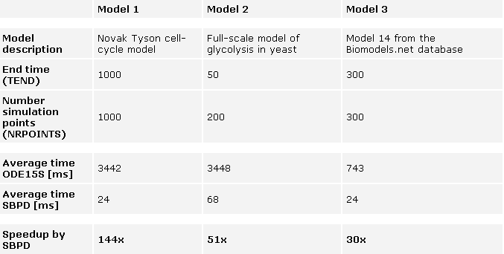
MEX Simulation Functions – Why?
Parameter estimation and clinical trial simulations require many repeated simulations
=> Simulation speed matters a lot
Benchmark (MEX simulation functions vs. ODE15s)

Slide 15
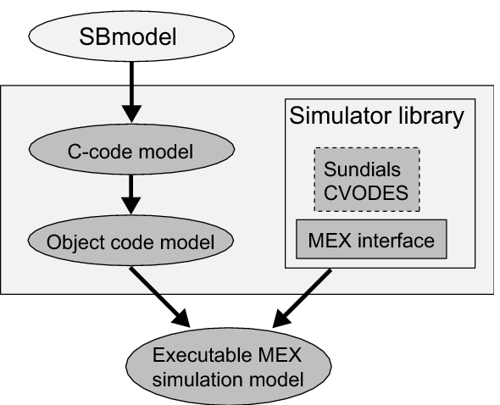
MEX Simulation Functions
What are MEX Simulation Functions?
Standard IQMmodel
Converted to C-code
IQMmodel
Compiled
Simulator library
Staticly linked
Executable MEX Simulation Function
that simulates the model for given parameters, initial conditions, and options

Slide 16
MEX Simulation Functions - Generation
A simple example (change into the „Example Files“ folder)
Simulation of a MEX model
The results of both simulations are identical
C-Conversion only (no compilation) => WYSIWYC
>> model = IQMmodel('model1.txt') % load a model
>> IQMmakeMEXmodel(model, 'model1MEX') % create a MEX simulation function
>> simdataMEX = model1MEX([0:0.1:25])
>> simdata = IQMsimulate(model,[0:0.1:25])
>> plot(simdataMEX.time,simdataMEX.statevalues,'k')
>> hold on; plot(simdata.time,simdata.statevalues,'r--')
>> IQMmakeMEXmodel(model,'MEXmodel',1) % convert to MEXmodel.c and MEXmodel.h
>> edit MEXmodel.c % look at the created files
>> edit MEXmodel.h
>> IQMmakeMEXmodel(model,'MEXmodel') % Same but with compilation!

Slide 17
MEX Simulation Functions – Syntax
How a MEX simulation function can be called
With prior definition of timevector, initialconditions, etc.:
output = MEXmodel()
output = MEXmodel('states')
output = MEXmodel('parameters')
output = MEXmodel('parametervalues')
output = MEXmodel(timevector)
output = MEXmodel(timevector, initialconditions)
output = MEXmodel(timevector, initialconditions, parametervector)
output = MEXmodel(timevector, initialconditions, parametervector, options)

Slide 18
MEX Simulation Functions – Syntax
Options for MEX model simulation (more available, see help text)
More information and options available in documentation
options.abstol: Absolute tolerance (default: 1e-6)
options.reltol: Relative tolerance (default: 1e-6)
options.minstep: Minimal integrator step size (default: 0)
options.maxstep: Maximal integrator step size (default: inf)
options.maxnumsteps: Maximal number of steps between two output points (default: 500)
options.xdotcalc: =0: do integration (default), =1: return RHS of ODEs for
given state and parameter values. Time information
is neglected and it is assumed that time=0.
>> help IQMmakeMEXmodel

Slide 19
MEX Simulation
A simple example (change into the „Example Files“ folder)
Simulate again – in three different ways
Advantage of the IQMPsimulate function is that parameters and intial conditions can be changed more easily than when calling the MEX function directly
Please have a look at the documentation of IQMPsimulate
>> model = IQMmodel('model1.txt') % load a model
>> IQMmakeMEXmodel(model, 'model1MEX') % create a MEX simulation function
>> simMEX1 = model1MEX([0:0.1:25]) % Calling directly the MEX function
>> simMEX2 = IQMPsimulate('model1MEX',[0:0.1:25]) % Simulate MEX function
>> simMEX3 = IQMPsimulate(model,[0:0.1:25]) % create MEX function on the fly
>> help IQMPsimulate

Slide 20
Limitations of MEX Simulation Functions
The MEX models can not handle
  SBML Algebraic rules
  The fast reaction flag included in SBML
Delays and delayed events can be handled, but the simulation performance becomes VERY poor ... In this case the standard MATLAB simulation is faster
C compatibility necessary (no MATLAB functions can be used that do not exist in C)
  Several standard functions provided by IQM Tools (andIQM, delayIQM, indexmaxIQM, maxIQM, minIQM, multiplyIQM, orIQM, piecewiseIQM, piecewiseSmoothIQM, piecewiseT0IQM, xorIQM)

Slide 21
Tutorial Outline
General introduction to the IQM Tools Suite
High performance computation via MEX simulation functions
Model Simulation
  Standard
  Parametric sensitivity
IQMprojectSB - parameter estimation, model reduction

Slide 22
Deterministic Simulation
Serves also as example for using the Cell-Mode
Change into the „Example Files“ folder
  Read the documentation in the opened file
  Execute the cells sequentially by pressing „Ctrl+Enter“
>> edit simpleSimulation

Slide 23

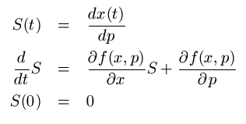
Forward Sensitivity Analysis
Determine the sensitivy trajectories wrt to perturbations in IC and parameters
>> model = IQMmodel('novaktyson1.txt')
>> output = IQMsensitivity(model, [0:1:200], {'k1', 'Ka', 'khs'}, {'Cyclin','YT'})
output =
time: [1x201 double]
states: {'Cyclin' 'YT' 'PYT' 'PYTP' 'MPF' 'Cdc25P' 'Wee1P' 'IEP' 'APCstar'}
statevalues: [201x9 double]
variables: {'k2' 'kwee' 'k25'}
variablevalues: [201x3 double]
reactions: {'R1' 'R2' 'R3' 'R4' 'R5' 'R6' 'R7' 'R8' 'R9' 'R10' 'R11' 'R12' 'R13' 'R14' ... 'R19'}
reactionvalues: [201x19 double]
sensparameters: {'k1' 'Ka' 'khs'}
paramtrajectories: [1x1 struct]
sensicstates: {'Cyclin' 'YT'}
ictrajectories: [1x1 struct]
>> output.paramtrajectories
ans =
states: {[201x9 double] [201x9 double] [201x9 double]}
variables: {[201x3 double] [201x3 double] [201x3 double]}
reactions: {[201x19 double] [201x19 double] [201x19 double]}

Slide 24
Forward Sensitivity Analysis
The function IQMsensitivity can be used on IQMmodels or on MEX simulation functions
Underlying the CVODES integrator is used to determine the sensitivity trajectories
This is considerably faster than determining the sensitivities by finite differences and repeated simulations
>> IQMmakeMEXmodel(model,'modelMEX')
>> output = IQMsensitivity('modelMEX',[0:1:200], {'k1', 'Ka', 'khs'}, {'Cyclin','YT'})
output =
time: [1x201 double]
states: {'Cyclin' 'YT' 'PYT' 'PYTP' 'MPF' 'Cdc25P' 'Wee1P' 'IEP' 'APCstar'}
statevalues: [201x9 double]
variables: {'k2' 'kwee' 'k25'}
variablevalues: [201x3 double]
reactions: {'R1' 'R2' 'R3' 'R4' 'R5' 'R6' 'R7' 'R8' 'R9' 'R10' 'R11' 'R12' 'R13' 'R14' ... 'R19'}
reactionvalues: [201x19 double]
sensparameters: {'k1' 'Ka' 'khs'}
paramtrajectories: [1x1 struct]
sensicstates: {'Cyclin' 'YT'}
ictrajectories: [1x1 struct]
>> output.paramtrajectories
ans =
states: {[201x9 double] [201x9 double] [201x9 double]}
variables: {[201x3 double] [201x3 double] [201x3 double]}
reactions: {[201x19 double] [201x19 double] [201x19 double]}

Slide 25
Tutorial Outline
General introduction to the IQM Tools Suite
High performance computation via MEX simulation functions
Model Simulation
IQMprojectSB - parameter estimation, model reduction
  Projects
  Parameter estimation / manual tuning / parameter fit analysis / parameter identifiability analysis
  Model reduction
  Simulation of projects
  Commenting of projects

Slide 26
Projects
  Modeling example
IQMprojectSB

Slide 27
Modeling Projects: IQMprojectSB
An IQMprojectSB is a container for
  Models
  Measurement data
  Experiment descriptions
  Modeling information
Parameter estimation, etc., can directly be run on projects
When modeling a system we build a project
IQMprojectSB
IQMmodel
IQMmodel
IQMmodel
IQMmodel
IQMmodel
IQMmeasurement
IQMmodel
IQMmodel
IQMexperiment
Let‘s do it!

Slide 28
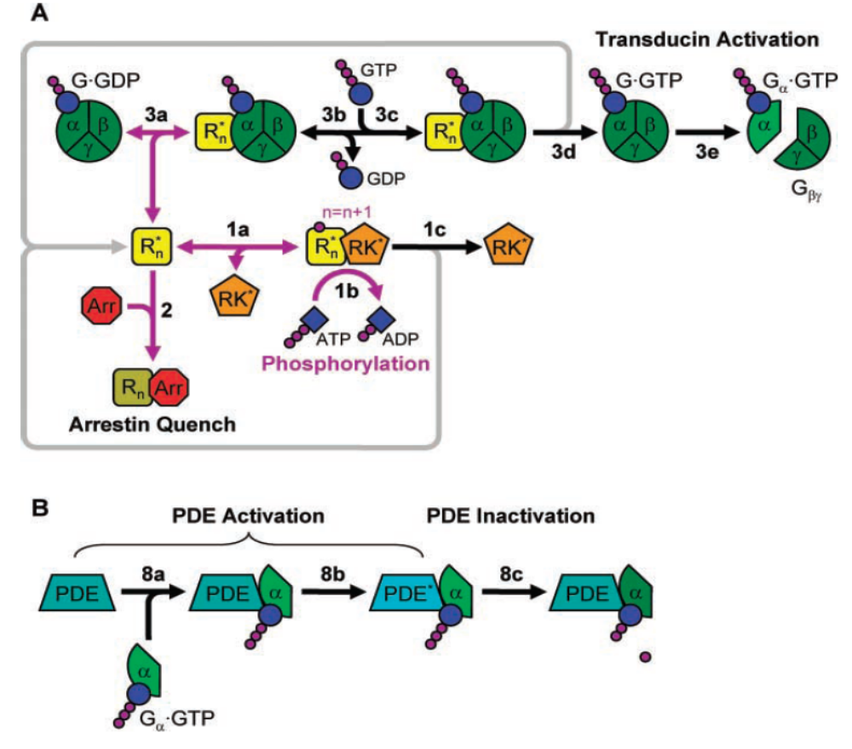
The System to be Modeled:
Photo Transduction in Rod Cells
The example shown in the following is adapted for this tutorial

Slide 29
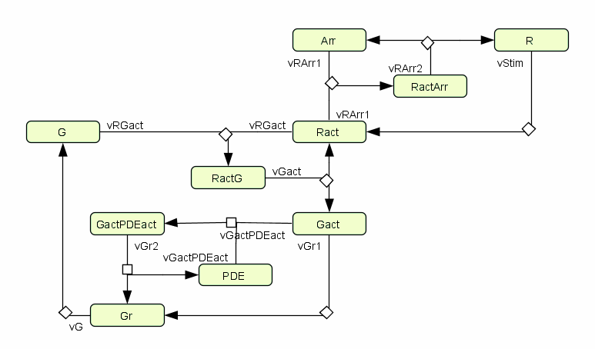
1) Model Network Structure
Components
Interactions
Stoichiometry
Adding mathematics in graphical tools is often a pain

Slide 30
2) Kinetic Rate Laws
Export graphical model to SBML => Import to IQM Tools
Add kinetic rate expressions in the IQMmodel
  We start simple, by assuming mass action kinetics
  Only in a single reaction we assume Michaelis Menten kinetics
Initialize parameters with guessed values
  Nothing known about the parameters => we set all to „1“

Slide 31
3) Initial Conditions
In this example we assume that:
Carefully undertaken experiments showed that the number of molecules of the involved species (WT) in the inactive state (thus their total amount) is as follows:
R = 500
G = 3000
Arr = 5
The number of PDE molecules is unknown but believed to be somewhere between 10 and 1000
All remaining species have an initial amount of 0

Slide 32
The Initial Model
Based on the previous information we can construct an IQMmodel representation
Change into the folder:
„Example Files\projectexample\phototransduction project\models”
Have a look at the model
Realizing the pulse stimulation:
stimulus = piecewiseIQM(magStim,le(time,durStim),0)
>> edit model.txtbc % or just doubleclick on the model file

Slide 33
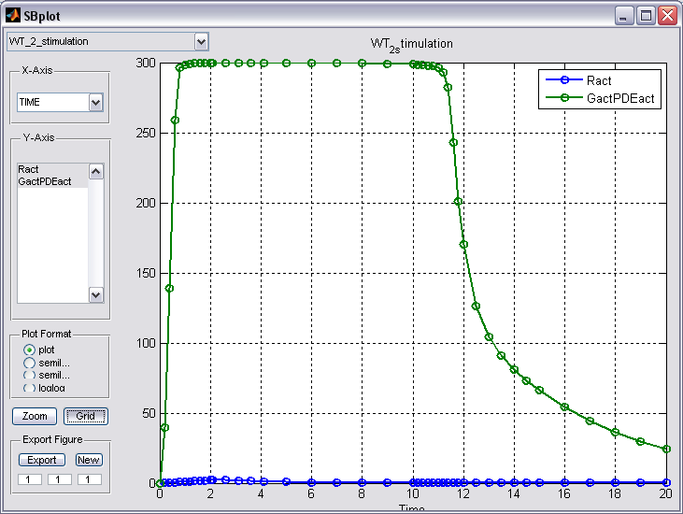
4) Measurement Data
The experimentalists gave us 4 documented CSV data files
  Time-series measurement data
  of Ract and GactPDEact
  Information about the biological
  experiments that have been performed
  to obtain the data
  The information in the documentation
  is the base for the specification of the
  experiment descriptions

Slide 34
Experiments and Measurements
Time-series data measured
different
stimuli
measured
single knock-outs

Slide 35
5) Constructing Experiment Descriptions
Change into the folder:
„Example Files\projectexample\phototransduction project\experiments\deltaArr_01”
Have a look at the measurement documentation
Define experiment description:
>> edit deltaArr_0point1_stimulation.csv % or right-click => “open as text”
********** EXPERIMENT INITIAL PARAMETER AND STATE SETTINGS
Arr(0) = 0 % knock-out
magStim = 2
durStim = 0.1
>> edit deltaArr_0point1_stimulation.exp % or right-click => “open as text”

Slide 36
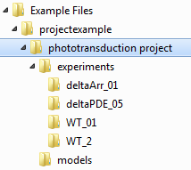
Representation of IQMprojectsSB
Folder structure, containing
  Models
  Experiments
  Measurements
Experiment folders containing experiment description file and corresponding measurement data
Folder containing model(s)
TEXT (ODE and/or BC) and/or SBML
Use telling names for the experiment folders. It will help you later!

Slide 37
Projects – Import and Information
Change into the „example files/projectexample “ folder
Import of the project
Project information
>> sbp = IQMprojectSB('phototransduction project')
IQMprojectSB
============
Name: phototransduction project
Number Models: 1
Number Experiments: 4
Number Measurements: 4
Number Estimations: 0
>> IQMinfo(sbp)
===PROJECT INFO===============================================
Project name: phototransduction project
---NOTES------------------------------------------------------
Project notes: This is an example project for the IQM Tools tutorial
In this notes.txt file you can document your project. Additionally,
you can add all kinds of additional documents in the different folders.
---MODELS-----------------------------------------------------
Model 1: Project_example_model
---EXPERIMENTS------------------------------------------------
Experiment 1: WT_0point1_stimulation
Measurement 1: WT_0point1_stimulation
Experiment 2: WT_2_stimulation
Measurement 1: WT_2_stimulation
Experiment 3: deltaARR_0point1_stimulation
Measurement 1: deltaArr_0point1_stimulation
Experiment 4: deltaPDE_0point5_stimulation
Measurement 1: deltaPDE_0point5_stimulation
---ESTIMATIONS------------------------------------------------
0 estimations present
==============================================================

Slide 38
Adding New Experiment Results
Create new folder in „experiments“ folder
Copy measurement data in (Excel or CSV file)
Create an experiment description
DONE!
Names in measurement files and experiment descriptions have to be the same as for the corresponding elements in the model

Slide 39
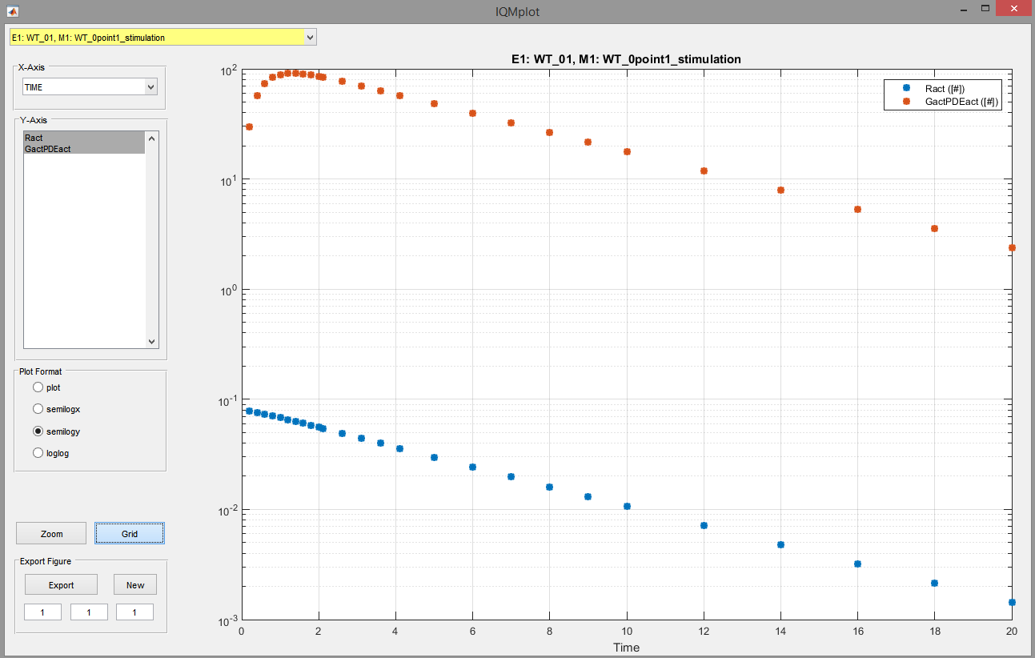
Projects – Visualize Measurement Data
Measurement data can be plotted by
>> IQMplotmeasurements(sbp)

Slide 40
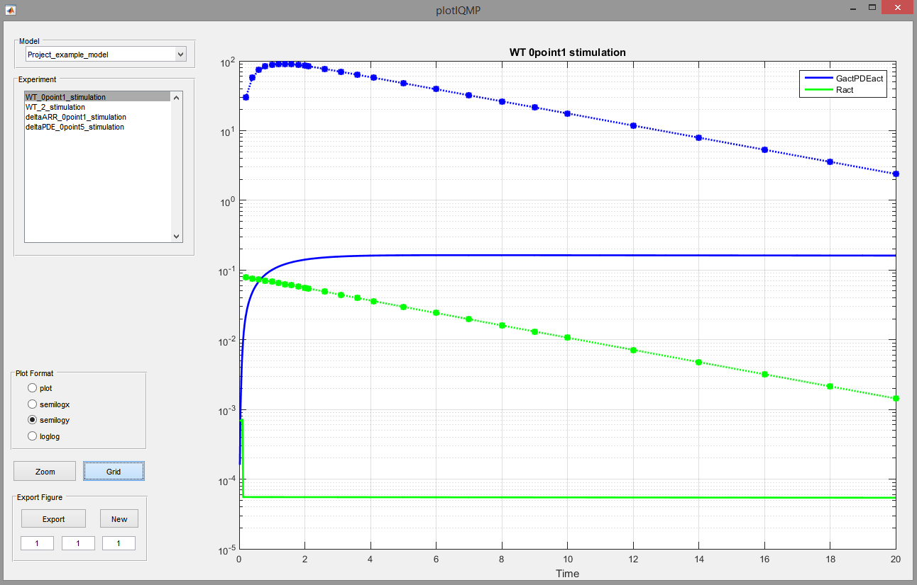
Projects – Simple Simulation
Simulation of the experiments in the project
Comparison with the measurement data
>> IQMcomparemeasurements(sbp)
Measurements (-o-)
Simulations (–)

Slide 41
Projects – Export
Saving a project as single binary file
  Saves the project in the file: projectfilename.iqmp
  Can be loaded again by
Exporting the project to a folder structure
  During export measurement data are always saved as CSV files!
>> IQMsaveproject(sbp,'projectfilename')
>> sbp = IQMprojectSB('projectfilename.iqmp')
>> IQMexportproject(sbp, 'projectfoldername')

Slide 42
Parameter estimation / manual tuning / parameter fit analysis / identifiability analysis
IQMparamestGUI++

Slide 43
Project is Defined – What Now?
Several possibilities to perform parameter estimation, etc.
  All from command line (messy)
  Using a „runEstimation“ script (easy ... we will see it later)
  Using a graphical user interface (easy)
Start the GUI
>> IQMparamestGUI

Slide 44
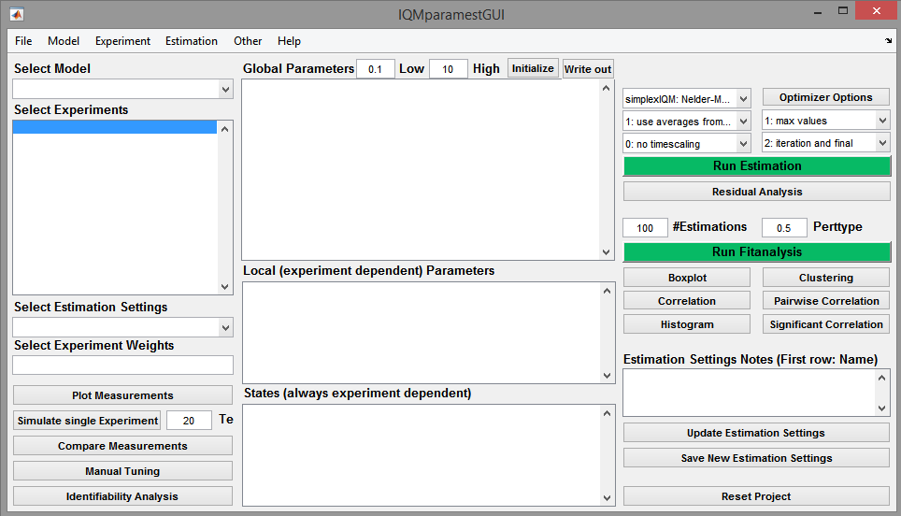
IQMparamestGUI
Select ”File”->”Import Project”
Then navigate to ”Example files/projectexample” and select ”phototransduction project”

Slide 45
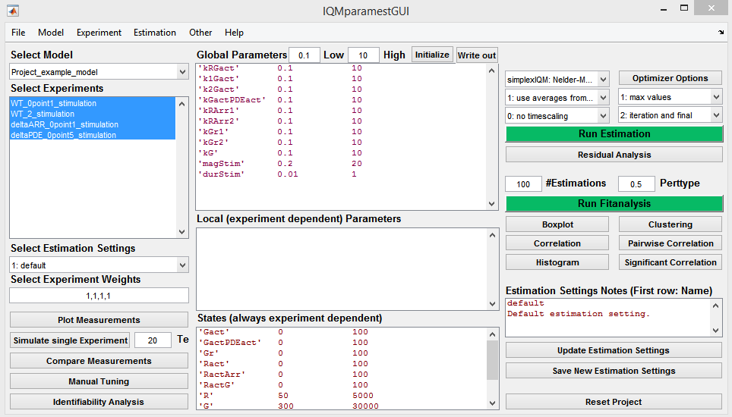
IQMparamestGUI
Select the model to fit
(only one model present)
Select the experiments to consider for fitting (select the first three, the last is kept for validation)
Set the weights for the different experiments (keep on ”1”s)
Try these buttons to plot measurements, compare measurements, etc.
Use manual tuning to tune parameters. This updates the project in the IQMparamestGUI

Slide 46
IQMparamestGUI
Click this button to attach
IQMparamestGUI to the MATLAB desktop

Slide 47
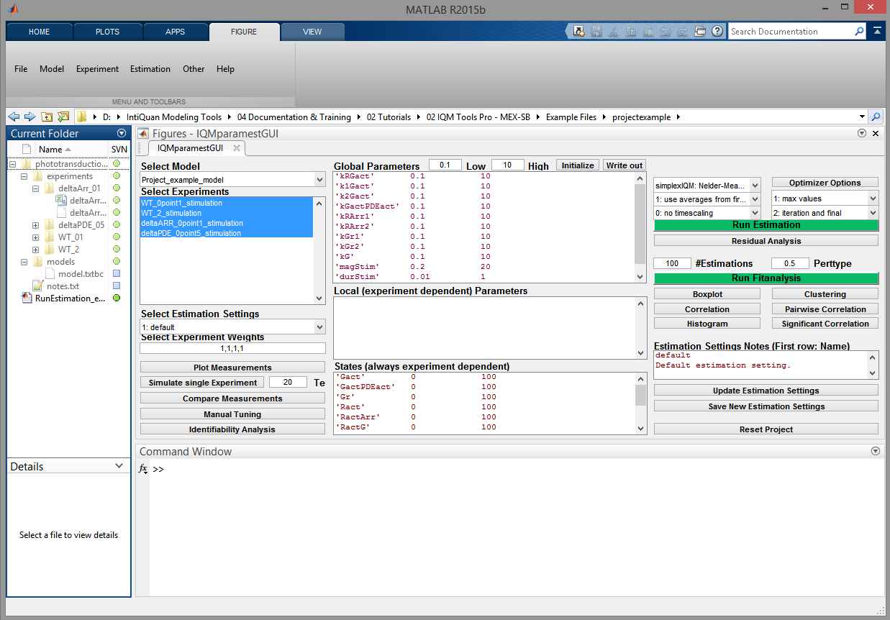
IQMparamestGUI
Work with the GUI and see the results in the MATLAB output without clicking around the windows

Slide 48
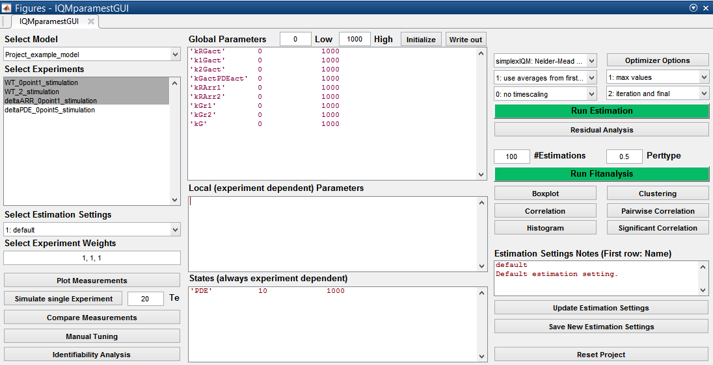
IQMparamestGUI
Try these buttons, they help to construct the list of
parameters and initial conditions to estimate
Select the (global) parameters to estimate:
’parameter name’, lower bound, upper bound
(We do not have a clue about the correct parameters, so we just guess something 0 ... 1000)
We do not need to estimate
local parameters in this
project
Select the initial conditions to estimate (we know the bounds 0 ... 1000)

Slide 49
IQMparamestGUI
Select optimization method
(simplexIQM)
The other settings leave on default. More information about them can be found by typing:
”help IQMparameterestimation”
Edit optimizer options
(leave on defaults)
Click ”Run Estimation”
to start the estimation

Slide 50
Parameter Estimation
Parameter estimation
≠
Running an optimization and wait

Slide 51
Parameter Estimation
Different optimization methods are useful for different problems
Many options for optimization methods => translation of parameter estimation into optimizer options estimation
Simple guideline
  Start with a local optimimzation method and see how good it gets
  Restart optimization with a global method (here use fSSmIQM if you have installed the SSm GO toolbox, otherwise use, e.g., pswarmIQM)
  Iterate between optimization and checking the results using „Compare Measurements“ or „Manual Tuning“
  „Simulate Single Experiment“ helps in understanding what happens to the unmeasured parts in the model

Slide 52
Parameter Estimation 1st Preliminary Result
Estimated parameters
====================
kRGact = 0.76107
k1Gact = 999.989
k2Gact = 0.537476
kGactPDEact = 485.473
kRArr1 = 0.109028
kRArr2 = 12.9209
kGr1 = 0.0549069
kGr2 = 1.47609
kG = 0.466008
Estimated initial conditions
============================
PDE=115.492 (Experiment 1)
PDE=296.076 (Experiment 2)
PDE=921.481 (Experiment 3)
Optimal cost: 0.036001
VERY close to the upper bound => lets increase the upper bound to 10000
=> restart optimization
(preferably using first a local method: simplexIQM,
alternating with fSSmIQM)

Slide 53
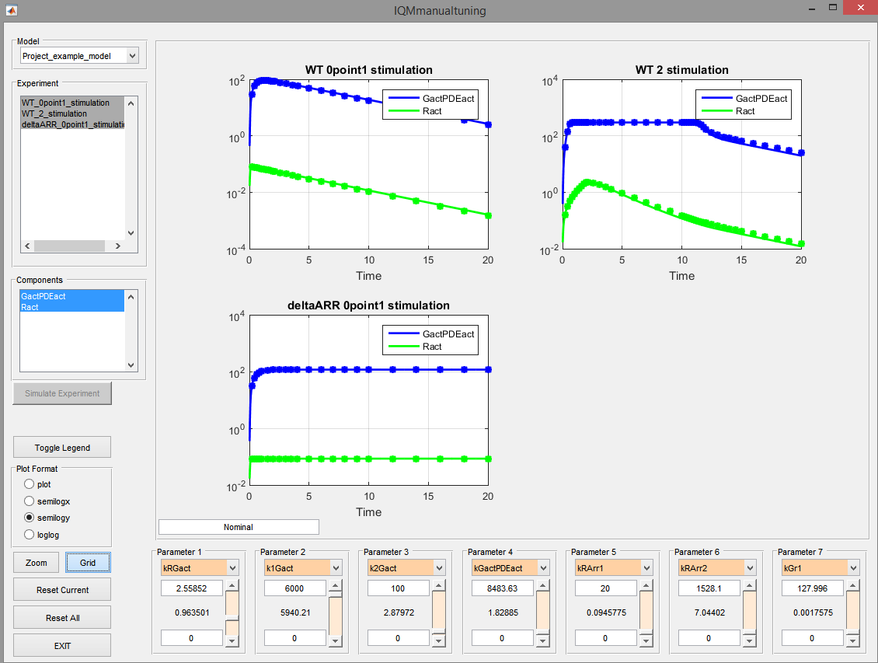
Parameter Estimation 2nd Preliminary Result
Estimated parameters
====================
kRGact = 1.19197
k1Gact = 6277.36
k2Gact = 2.56596
kGactPDEact = 0.362095
kRArr1 = 0.104435
kRArr2 = 0.289185
kGr1 = 2.92379e-018
kGr2 = 2.31828
kG = 1.40081
Estimated initial conditions
============================
PDE=122.636 (Experiment 1)
PDE=300.322 (Experiment 2)
PDE=141.934 (Experiment 3)
Optimal cost: 0.000615584
Use „Manual Tuning“ or „Compare Measurements“
=> Fit seems acceptably nice

Slide 54
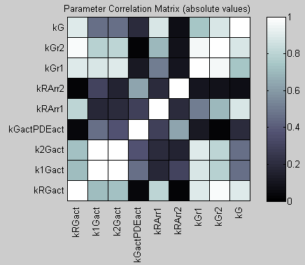
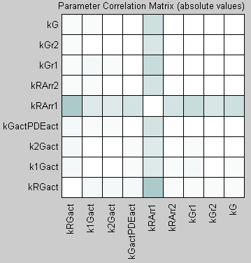
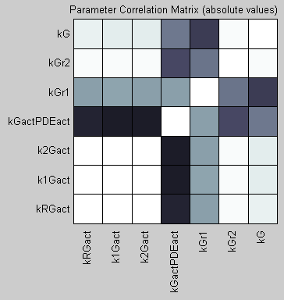
A Posteriori Identifiability Analysis
Select one experiment at a time and click the „Identifiability Analysis“ button
Experiment 1
Experiment 2
Experiment 3

Slide 55
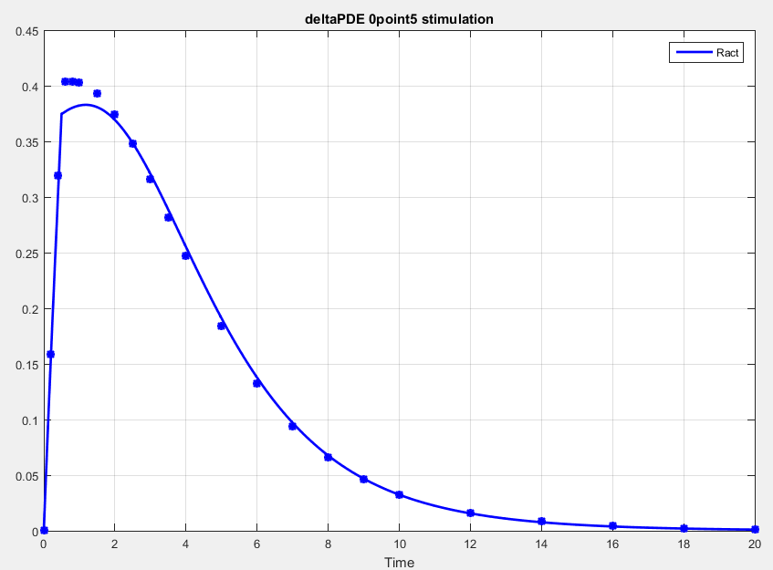
Validation of Models‘ Predictiveness
Simulate the last experiment, which was not used for estimation
Not perfect, but we have seen worse in other projects ☺

Slide 56
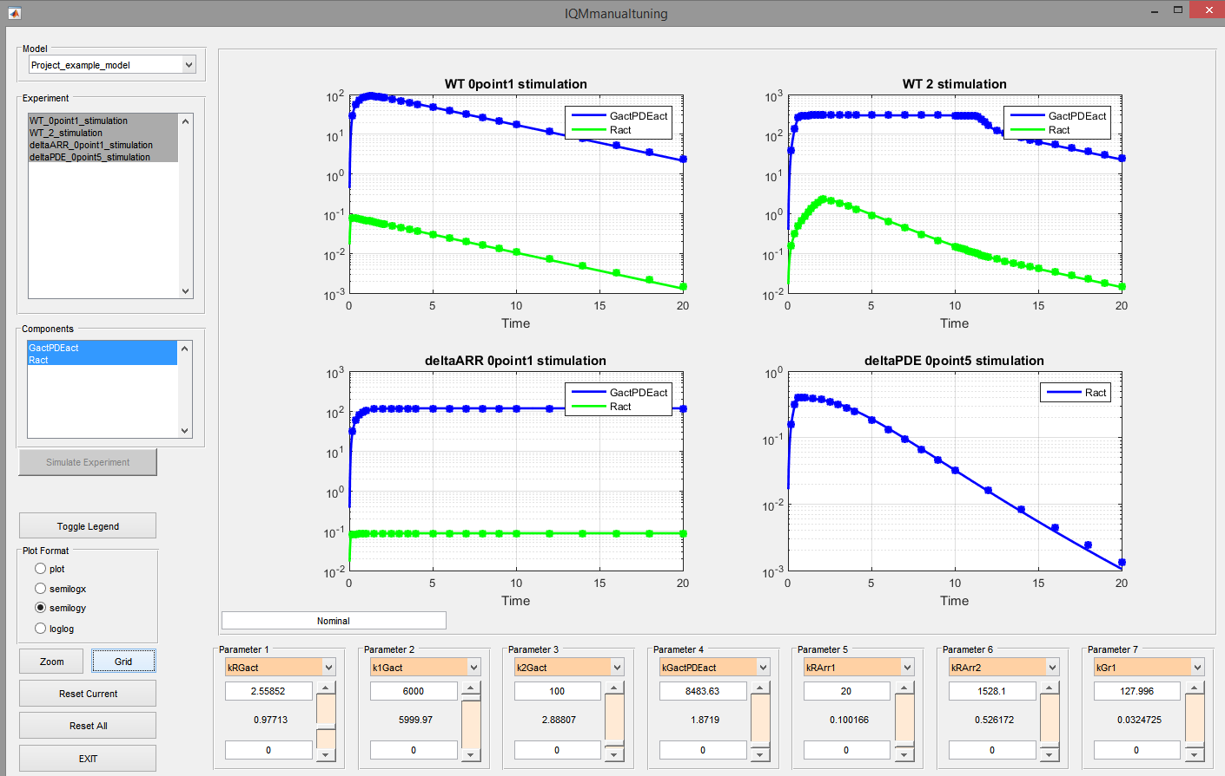
Don‘t Waste Measurement Data
One we have seen that the model is able to predict our validation data we should use these data to improve the model
Reduce the upper bounds according to the current optimized values
Again use simplexIQM and fSSmIQM sequentially
Estimated parameters
====================
kRGact = 1.15041
k1Gact = 9994.95
k2Gact = 4.18729
kGactPDEact = 0.373298
kRArr1 = 0.101745
kRArr2 = 0.397964
kGr1 = 0.0171438
kGr2 = 2.30743
kG = 2.36096
Estimated initial conditions
============================
PDE=128.758 (Experiment 1)
PDE=302.294 (Experiment 2)
PDE=152.618 (Experiment 3)
PDE=39.4611 (Experiment 4)
Optimal cost: 0.000423773
These two seem to be correlated, since increasing together ... See also identifiability analysis

Slide 57
Save Optimized Project
To export the optimized project do the following
  Select „File“->“Export Project (Folder)“
  Navigate to the projectexample folder
  Click OK
  Type new name: „phototransduction_project_optimized”
Optimized global variables are stored in the model
Optimized initial conditions and local variables are stored in the experiment decriptions
Browse the newly created project folder and check the experiment descriptions and the model

Slide 58
Parameter Fit Analysis
Idea:
  randomly perturb starting conditions for estimation around current optimum
  perform optimization and collect optimal values
  repeat N times
  analyze results
Gives information about:
  parameter correlations
  local optima

Slide 59
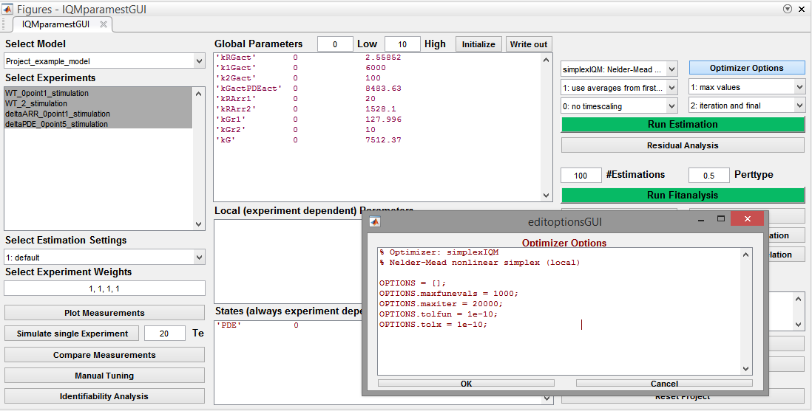
Parameter Fit Analysis
Select a local optimization method (simplexIQM)
Set maximum number of
cost function evaluations to a smaller value (saves time)

Slide 60
Parameter Fit Analysis
Select number of optimizations and the type of the perturbation (help IQMparameterfitanalysis)
Start the fit-analysis

Slide 61
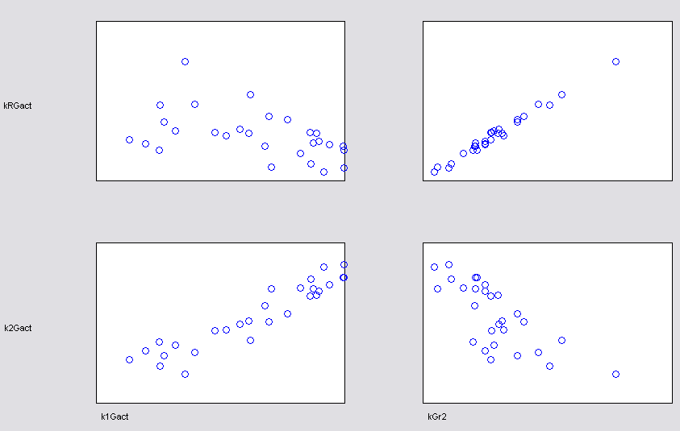
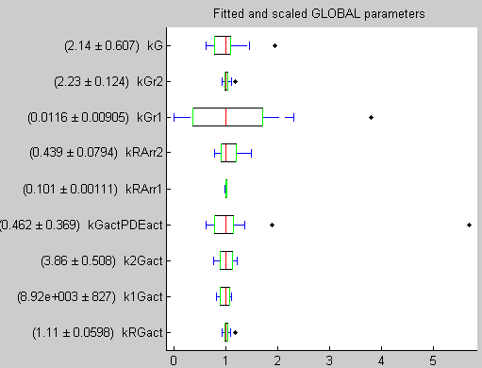
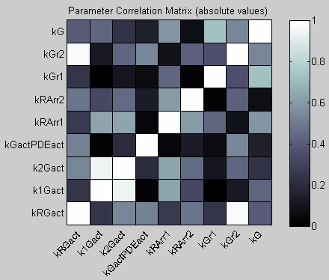
Parameter Fit Analysis
Correlation analysis: Even here k1Gact and k2Gact are highly correlated
Pairwise correlations
Boxplot
Correlations

Slide 62
Non GUI Estimation etc.
Parameter estimation does not require IQMparamestGUI
All functions are available on the command line
Using MATLABs Cell Mode => „comfortable“ estimation
Create a RunEstimation script
  In IQMparamestGUI choose „Other“->“Create RunEstimation Script“
  Navigate to the projectexample folder
  Select RunEstimation as name and save
Close IQMparamestGUI
>> edit RunEstimation
% Delete line 11
% Change line 12 to sbp = IQMprojectSB('phototransduction_project_optimized');

Slide 63
Model Reduction
IQMreducerateexpressions
Schmidt, H. et al. (2008) Complexity Reduction of Biochemical Rate
Expressions, Bioinformatics, doi: 10.1093/bioinformatics/btn035

Slide 64
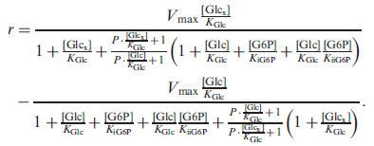

Model Reduction
Kinetic rate expressions can be very complex
Not always they do need to be so complex in order to describe the behavior of interest

Slide 65
Model Reduction
The function IQMreducerateexpressions allows to stepwise reduce complex kinetic expressions
Here we demonstrate its use based on the previous modeling example, where we unnecessarily used a Michaelis Menten term

Slide 66
Model Reduction
Load the optimized project
Run the model reduction
RESULT: Mass action kinetics is sufficient
More information
>> sbp = IQMprojectSB('phototransduction_project_optimized')
Works only when the symbolic toolbox is available
>> IQMreducerateexpressionsProject(sbp)
>> help IQMreducerateexpressionsProject

Slide 67
Simulation of IQMprojectsSB

Slide 68
Simulation of Projects
Change into the „Example Files/projectexample“ folder
Compare measurements
Manual tuning
These commands take a while to execute, since compilation is done
>> sbp = IQMprojectSB('phototransduction_project_optimized') % import the project
Created
previously
>> IQMcomparemeasurements(sbp) % simulate all experiments and model in the project
% and compare results to measurements
>> help IQMcomparemeasurements
>> IQMmanualtuning(sbp) % simulate selected experiments and model in the project
% and compare results to measurements + allow tuning
>> help IQMmanualtuning

Slide 69
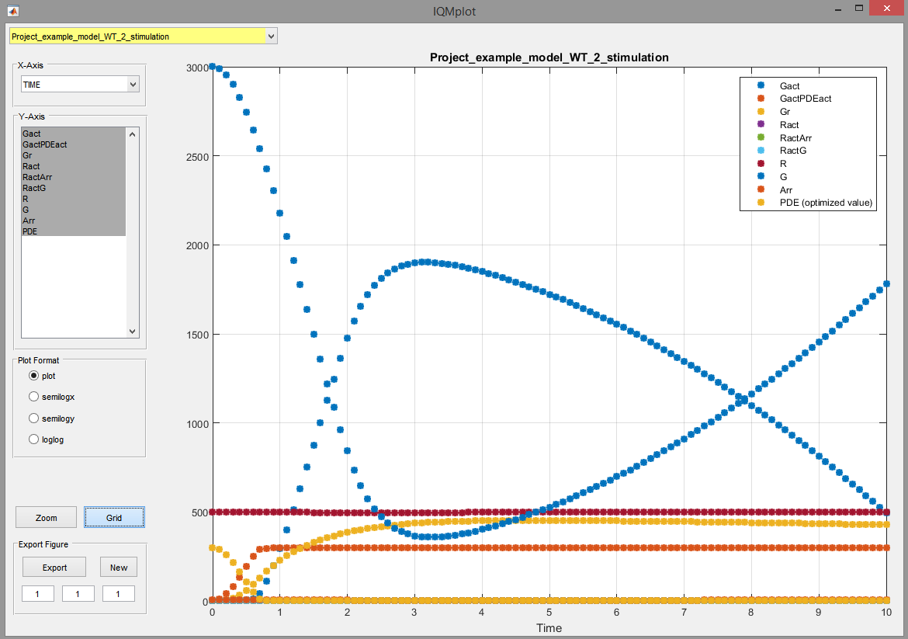
Simulation of Projects
Simulating in silico experiments
Per default the result is plotted
Optionally, the result can be saved
  CSV file
  Excel file
Or as IQMmeasurement be returned to the workspace
>> model = IQMgetmodel(sbp,1) % get first model from project sbp
>> experiment = IQMgetexperiment(sbp,2) % get second experiment from project sbp
>> IQMinsilicoexp(model,experiment,[0:0.1:10])
>> help IQMinsilicoexp

Slide 70
Simulation of Projects
Instead of extracting models and experiments in silico experiments can directly be performed on projects:
Per default the result is saved in a CSV measurement file
Optionally, the result can be
  displayed using IQMplot
  saved as an Excel measurement file
  returned to the workspace as an IQMmeasurement
>> modelindex = 1 % first model from project sbp
>> experimentindex = 2 % second experiment from project sbp
>> IQMinsilicoexpproj(sbp,modelindex,experimentindex,[0:2:400]) % perform experiment
>> help IQMinsilicoexpproj

Slide 71
Commenting of projects

Slide 72
Commenting a Project
A project folder can contain a notes.txt file
  General information about the project
  Focus of the project: why modeling, what to do with the model, etc.
Every folder in a project can contain additional files. For example:
  Word(etc.) documents in the model or experiment folder(s), describing things more in detail
  Figures, spreadsheets, raw data files, ...
In this way the complete information about a modeling project can be contained in the folder structure of an IQMprojectSB
LIMITATION: Experiment folders should only contain Excel or CSV files that contain measurement data. However, these folders can contain additional folders in which all kinds of information can be stored.

Slide 73
Documenting the Validity of a Model
A model alone is NOT very useful
  SBML model
  *.txt or *.txtbc model
A model becomes useful if the following is known about it
  For what purpose has the model been build?
  Which experiments have been performed to generate data for fitting and validation?
  Under what conditions have the experiments been performed?
  Etc.

Slide 74
Documenting the Validity of a Model
Where to store that information in the framework of the IQM Tools Suite?
  In the projects
    The notes.txt can contain the purpose of the model and general assumptions
    The model files can contain additional information
    The experiment descriptions define the performed experiments and the conditions under which these experiments have been performed
Don‘t exchange models! Exchange projects!

Slide 75
Tutorial Goal: „You should now be able to“
Use MEX/C-code models for fast simulation
Calculate sensitivity trajectories with MEX models
Set up your own parameter estimation project
  Model description
  Measurement data
  Experiment descriptions
Perform parameter estimation, identifiability analysis, etc.
Analyze the resulting model

Slide 76
THE END
Thank you for your participation and interest!
The tutorial continues in Part 3 (IQM Tools Pro / Basic Pharmacometrics)

